Slide 1
Google HQ Breakfast Medispa Digital Masterclass

Slide 2
Questions For You
How many of you run marketing campaigns?
How many of you pay for advertising?
How many of you have been disappointed with results?

Slide 3
My Goal Today is
Educate you on our SMART process
Show you high converting landing pages
Answer some of the common questions
Explain the user engagement funnel
Long term strategy

Slide 4
Who We Are
Digital marketing agency
Google Premier Partner
Infusionsoft Partner
Offices in Brisbane and Melbourne
Specialities:
Lead generation
Conversion rate optimisation
Web development

Slide 5
Successes
First project – generated $250,000 first year
National & International clients
Run some of the best Search and Mobile campaigns
Average Adwords conversion rate – 11%
No contracts

Slide 7
S.M.A.R.T Process

Slide 8
In Order To Succeed Online You Need to be

Slide 9
Our definition of SMART is
Strategy
Message
Advertising
Results
Test & Measure

Slide 10
To Achieve This
80/20 Focus – Landing Pages
Ad Variations – Split Testing
Google ads – Immediate Exposure
Conversions – Calls and Enquiries/Sales
Google Analytics/Adwords Conversions

Slide 11
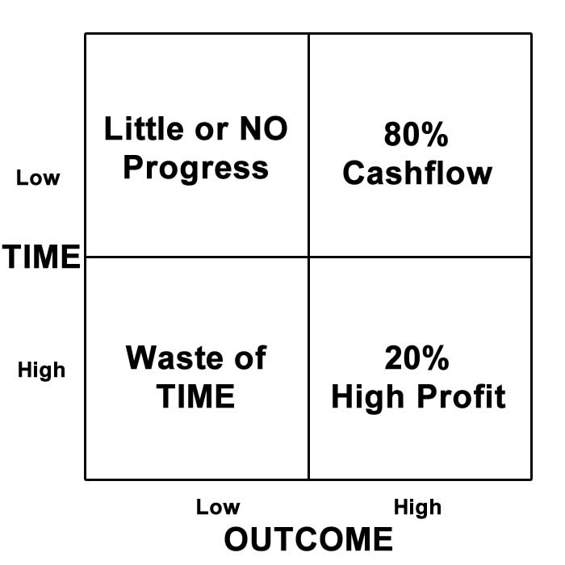
80/20 Service Analysis

Slide 12
High Converting Landing Pages

Slide 13
Common Mistakes
All traffic goes to home or service pages
Content is very general
Navigation distracts people
Fairly low conversion rates

Slide 14
Landing Pages
Answer all Basic Questions
1-2 Call-To-Actions
Easy to follow
Device friendly
Have social proof (testimonials)
Tracking setup

Slide 15
Average Campaigns

Slide 16
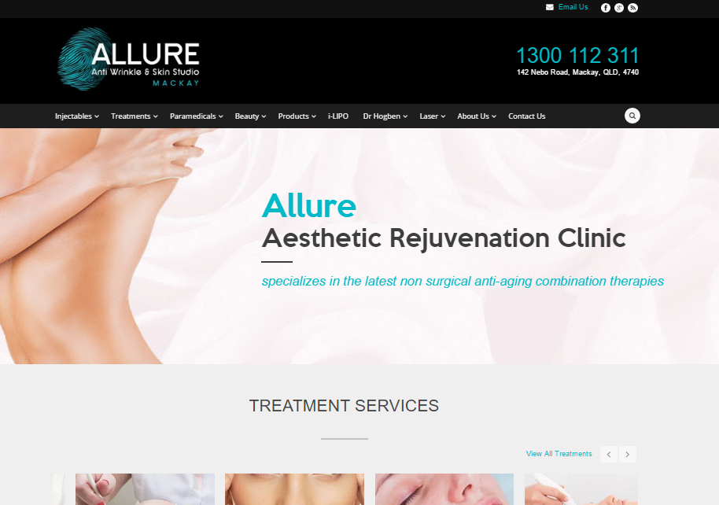

Slide 17
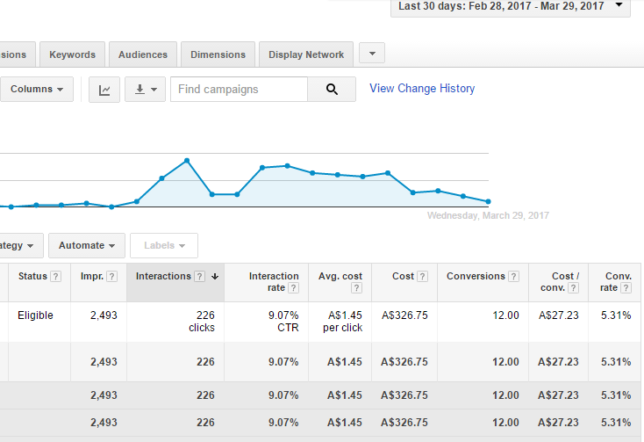

Slide 18
S.M.A.R.T Campaigns

Slide 19
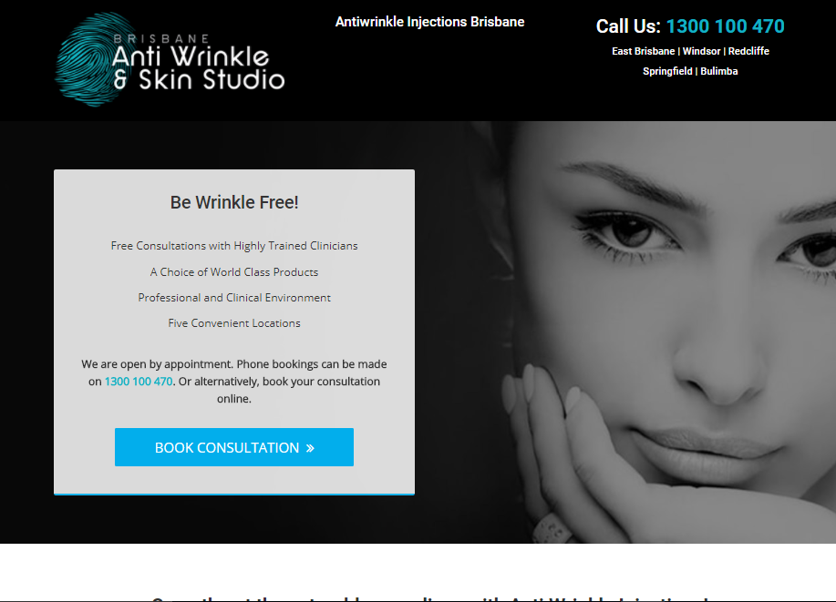

Slide 20
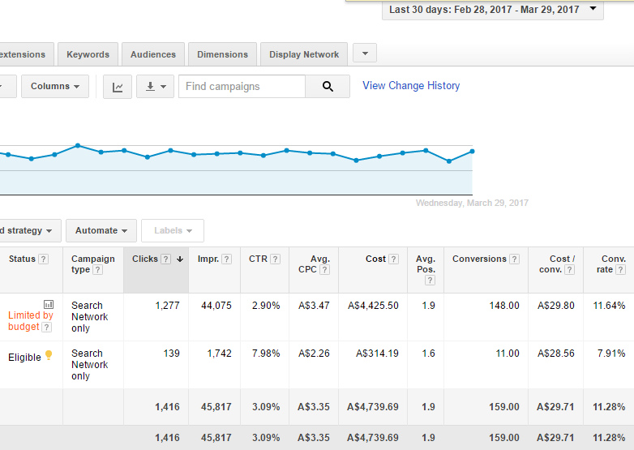

Slide 21
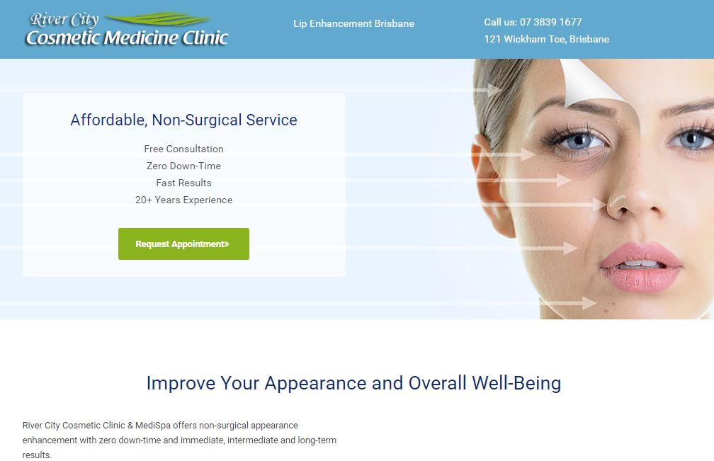

Slide 22
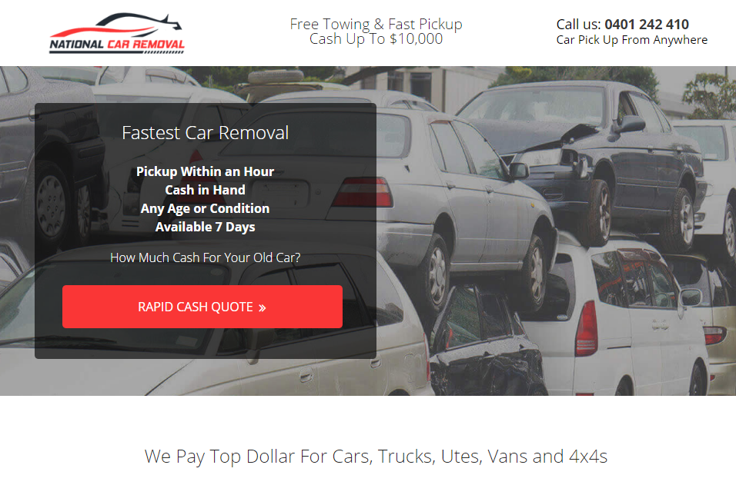

Slide 23
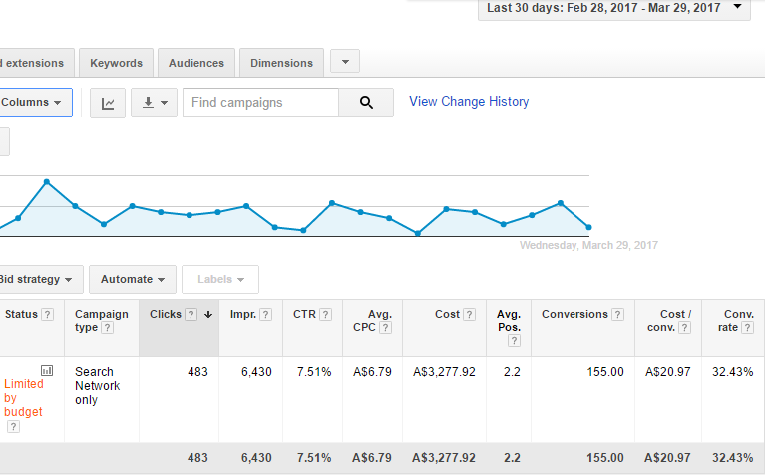

Slide 24
Landing Pages - Keep it simple
Attractive offer
Minimal number of call-to-actions (CTA)
Clear Unique Selling Point (USP)
Aim for conversion rate (over 5 %)
A/B Split Test
Headlines
Offers
With/without elements

Slide 25
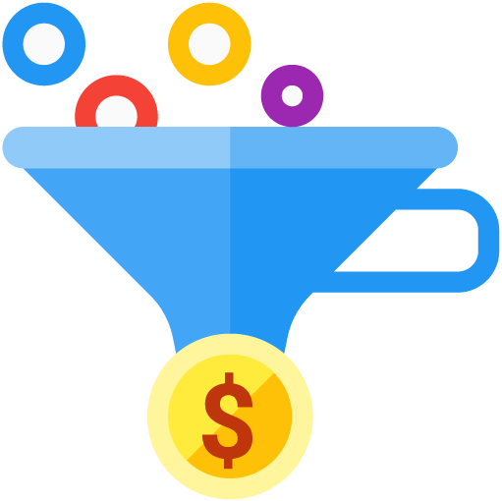
Conversion Rates
Low < 2%
Average – 2-3%
Good – 4-6%
Great – 7-12%
Awesome > 12%

Slide 26
Adwords and User Engagement Funnel

Slide 27
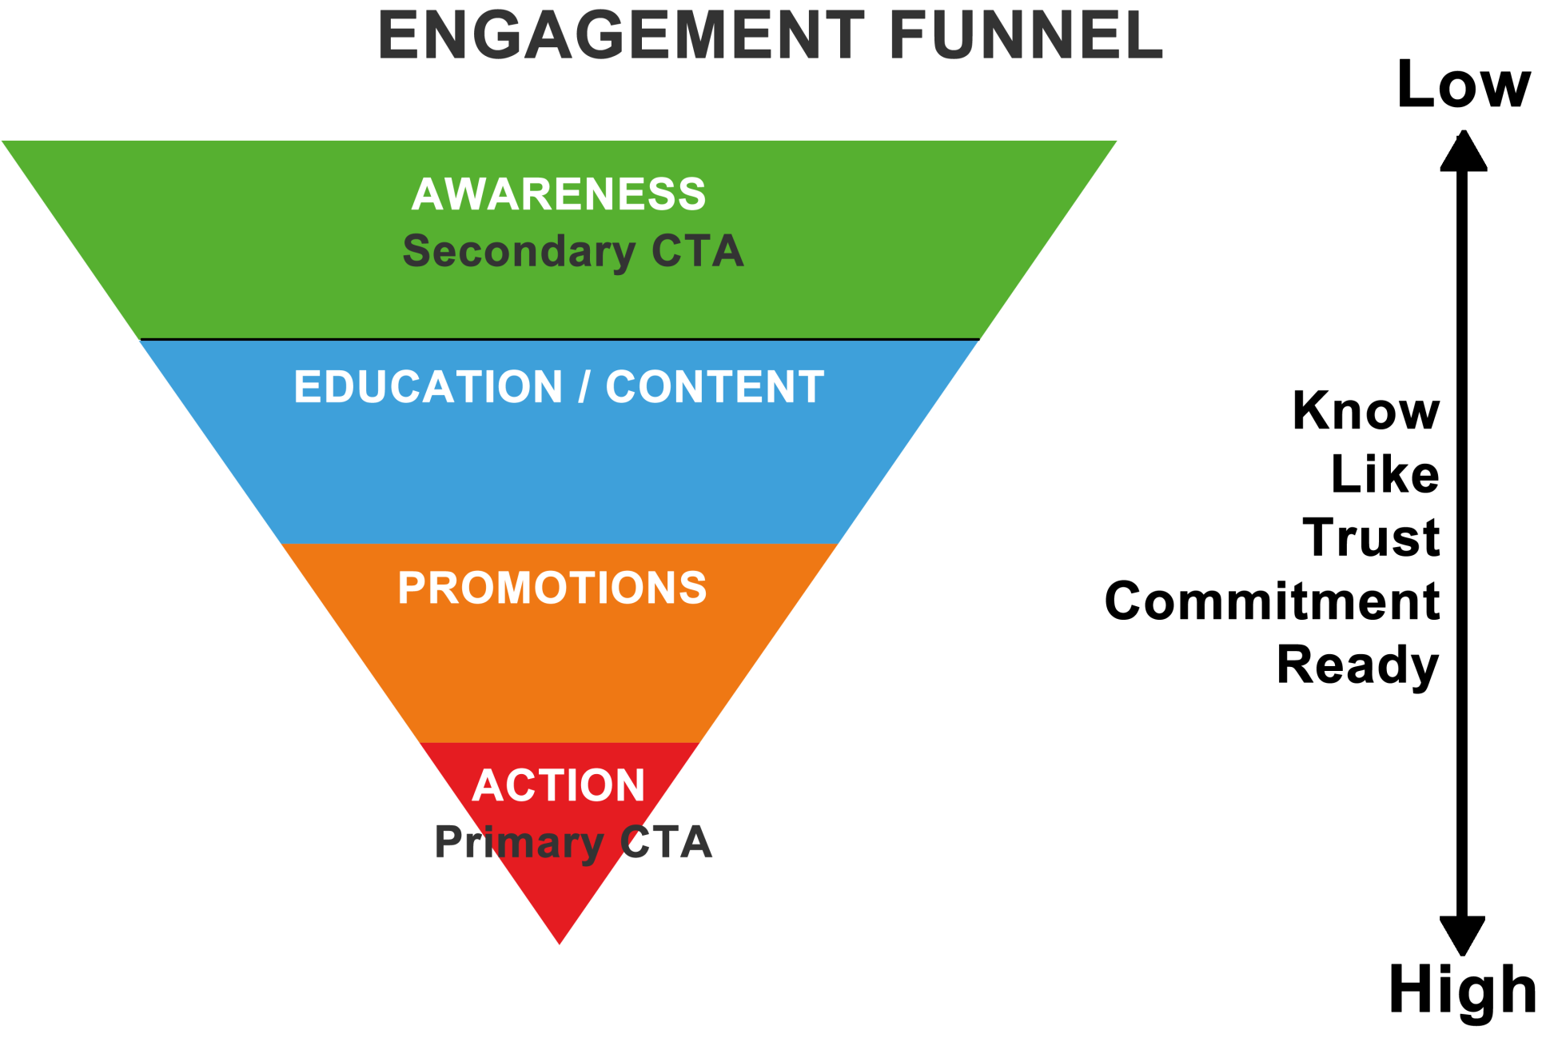

Slide 28
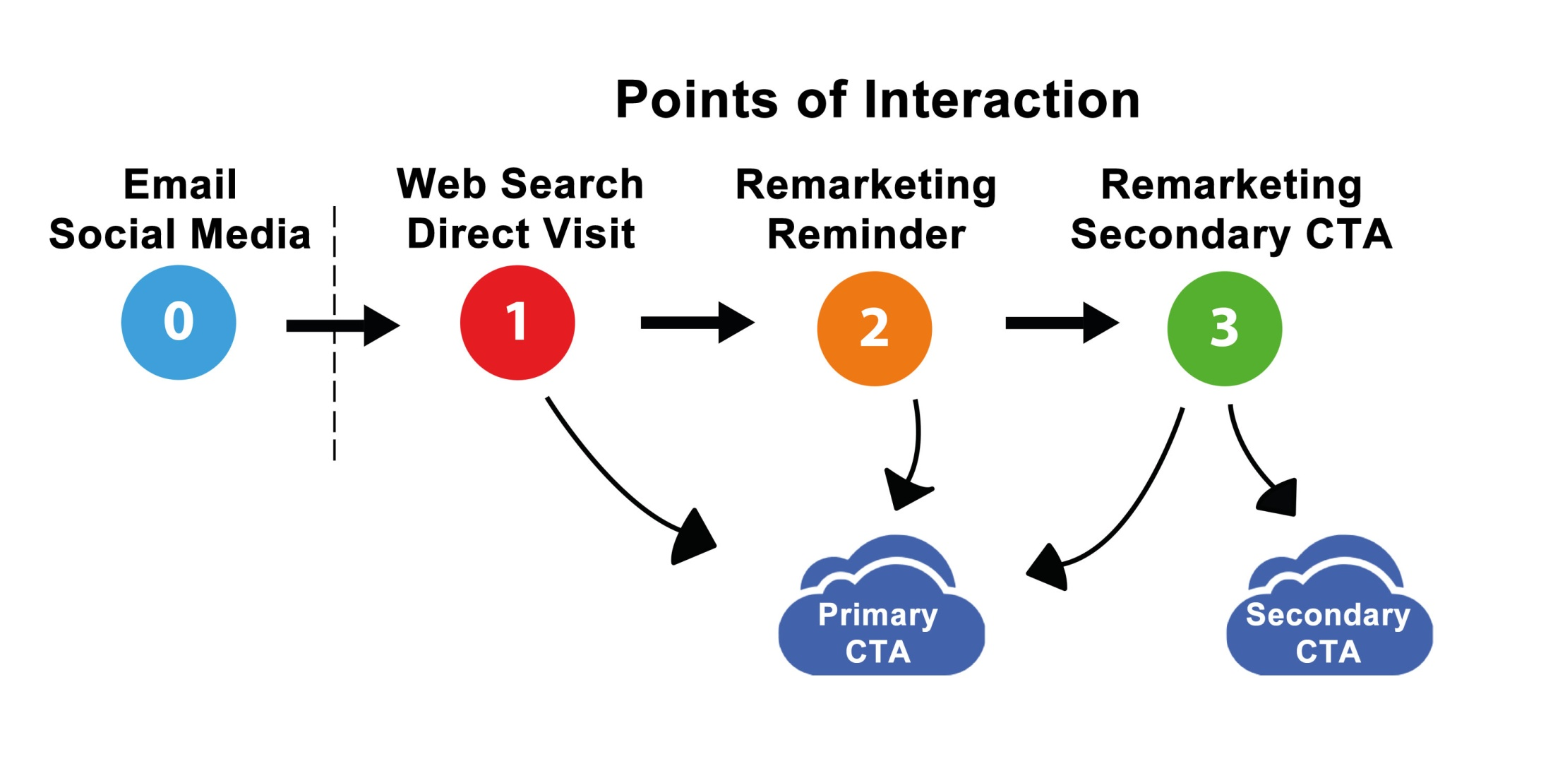

Slide 29
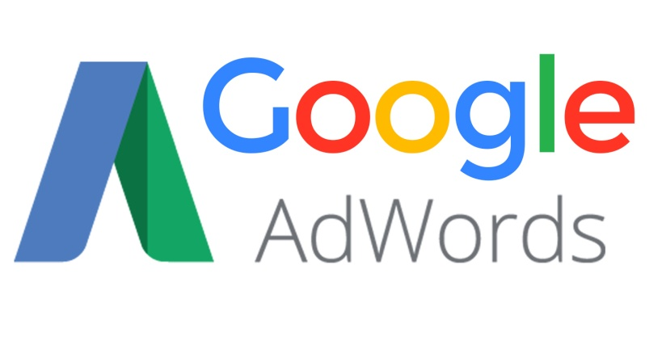
Adwords Applied To Engagement Funnel
Search – 85%
Action Focused
Point of difference
Remarketing – 5%
Action Focused/Promotions
Primary/Secondary CTA
Display/Youtube – 10%
Awareness Focused
Secondary CTA

Slide 30
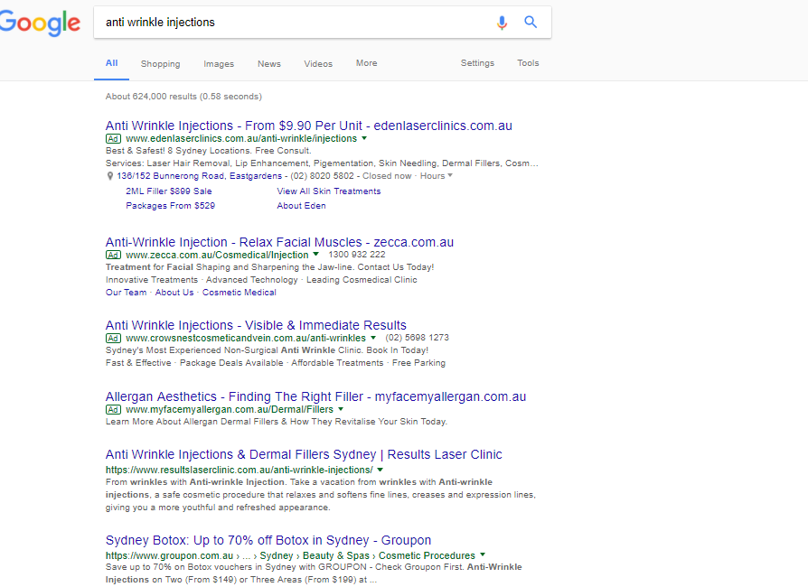

Slide 31
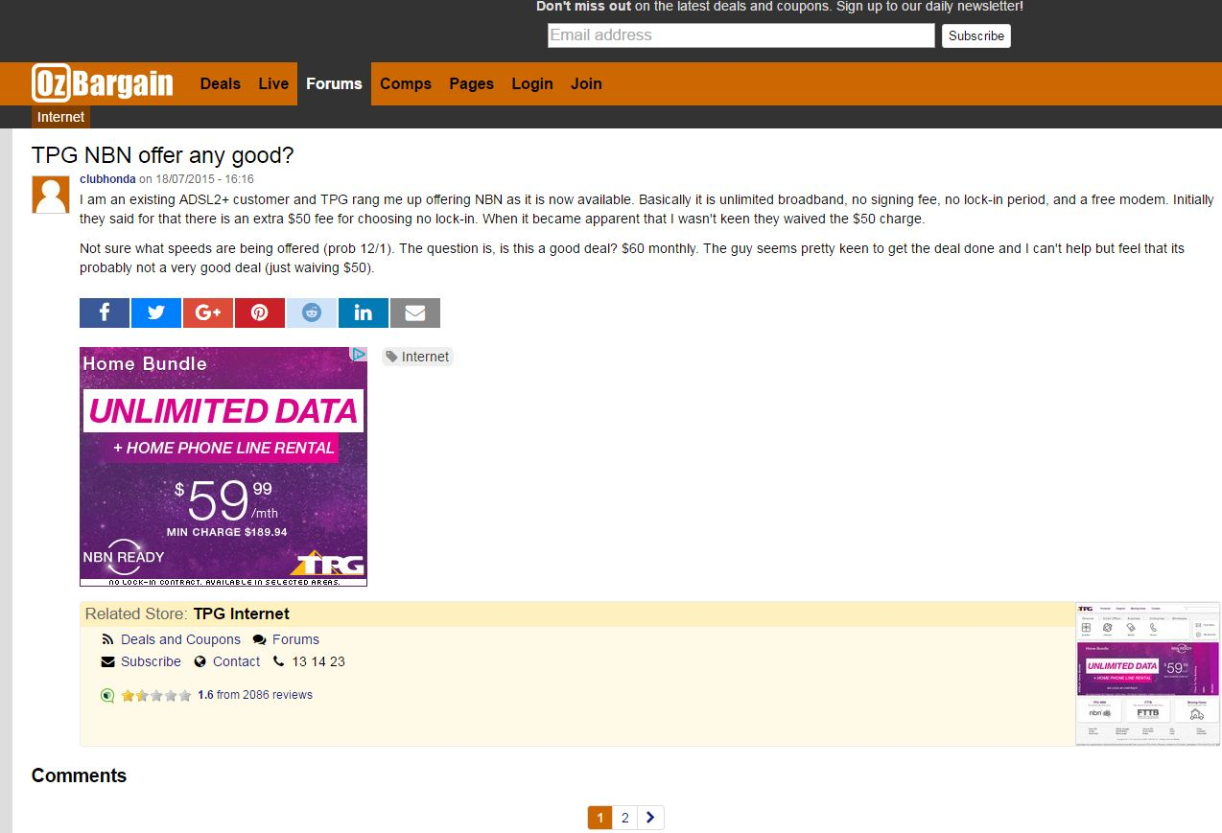

Slide 32
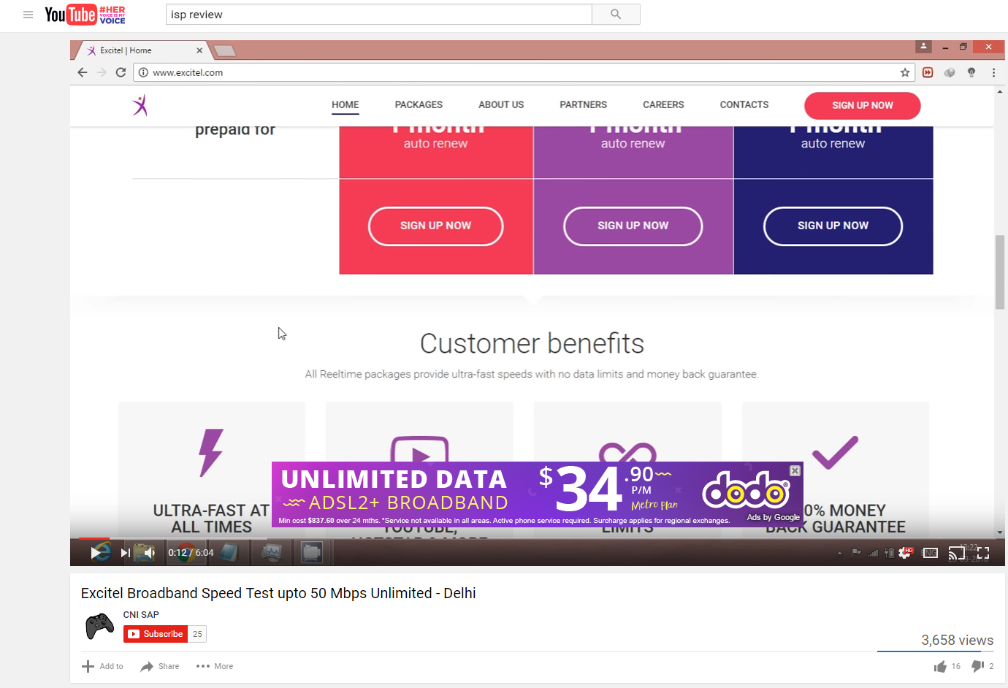

Slide 33
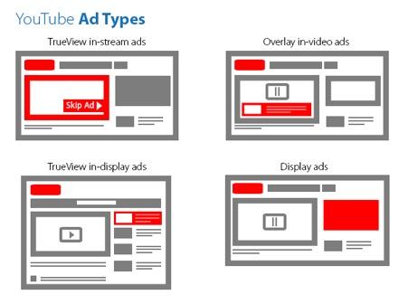

Slide 34
Case Study

Slide 36
Starting Point
Fast start
80/20 analysis
Starting point to build client relationship
Goals
Quick wins
Business bought
12 month
Australia POS system

Slide 37
Strategy in Setup
Keyword rich domain name
Adwords as immediate strategy
Professional website with focus on:
Convenience
Credibility
Doctor’s support
Other services
Professional approach

Slide 38
Strategy in Implementation (Nov 2014)
System Setup (Shortcuts) – appointment booking
Adwords campaign run for 30 days
Perform 80/20 to focus on conversions
Adwords to identify top performing keywords (TPK)
TPK for SEO
TPK for Google Business
Continue with Adwords
Increase budget for TPK to reach 100% reach

Slide 39
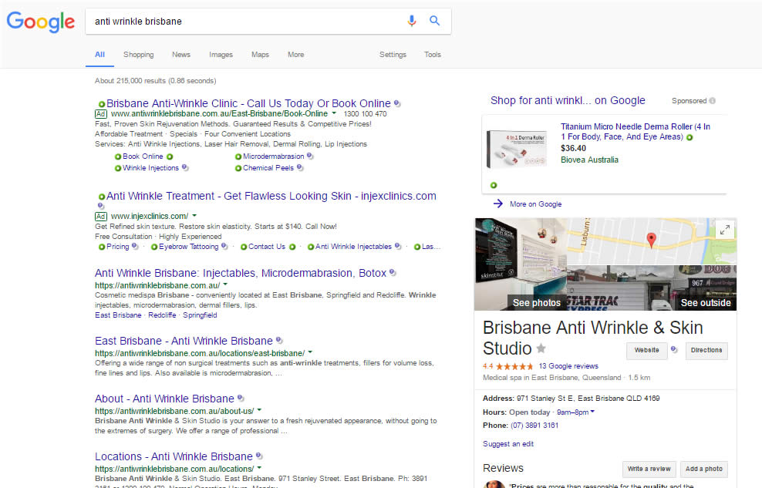

Slide 40
Second Year
Facebook marketing (via partners)
New services (Skin and anti ageing solutions)
New Adwords campaigns (for services)
SEO for less specific keywords
Email marketing campaigns using GCast/Mailchimp
Open up second location (Redcliffe)
Adwords to cover new location areas
SEO to follow

Slide 41
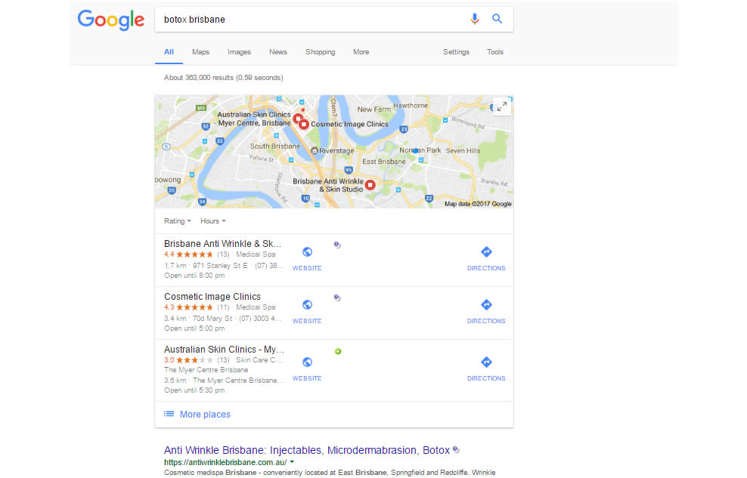

Slide 42
Third Year
Open up third location (Springfield)
New services (Laser)
Video campaigns
Upgrade email marketing to Infusionsoft (tagging)
Open up fourth location (Windsor)
Adwords campaign to focus on Windsor area
SEO to follow
Opened fifth location (Bulimba) – April
Planning sixth location (Cleveland) – End 2017

Slide 43
Long Term Strategy

Slide 44
Long Term Strategy
Perform 80/20 Analysis
Allocate budgets based on goals
Setup landing pages
Run Adwords campaigns
Dominate specific locations
Track performing keywords
Build lists (clients, enquiries, subscribers)
Run local SEO campaigns for performing keywords
Email marketing
Authority marketing

Slide 45
Questions?

Slide 46
Need Help?
Strategy
Website/CRM setup
Lead generation
Google Adwords / Analytics
Consulting
Expression of Interest

Slide 47
Contact
Email – alexei@yews.com.au
Twitter - @alexeikouleshov
Facebook - @youreasywebsolutions

